Slide 1

Group 22 Final Presentation 2nd Year Team Project 2021
By
Shane Mulrooney
Sean Fulton
Cree Gunning

Slide 2


Application Idea
Our Love for games
Fun but challenging experience
No end objective
Round based format

Slide 3


Target Audience
For People Who love games as much as us
Fans of top down style games
Fans of round based survival games

Slide 4

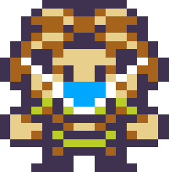
Technology and software used
Game Development Program Godot
Suited the needs and features of our game
Simple Character Animation
Collision Detection
Tile Maps
GDScript flexible and easy to learn

Slide 5
Project Plan
Preparatory Phase Full Understanding of Concept Development of Basic Functioning Game
Finishing Touches Final Testing and Debugging Phase

Slide 6
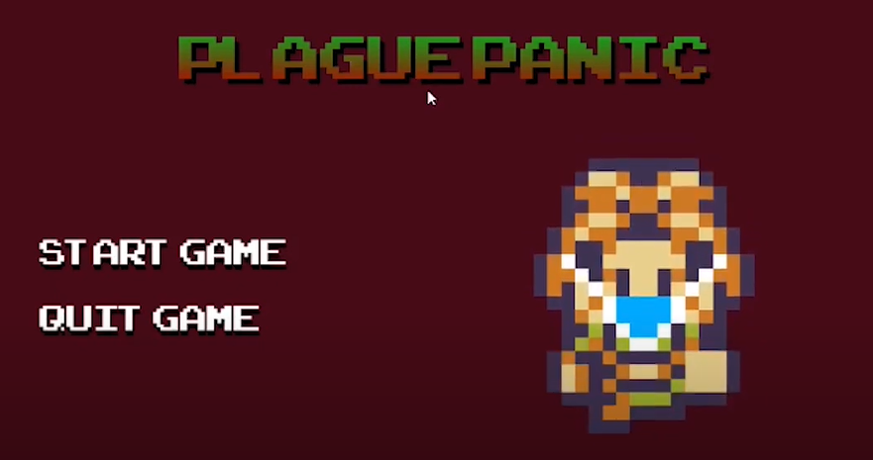
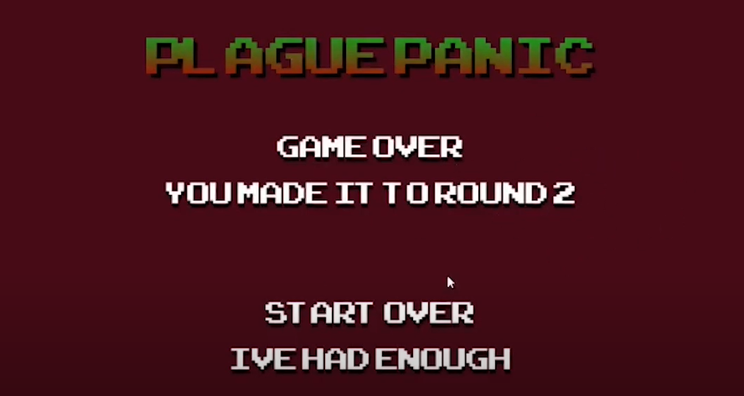
individual responsibilities
Shane
Project manager
Main menu
Cutscene
Game over
Music and sound
Player Walk Mechanic

Slide 7
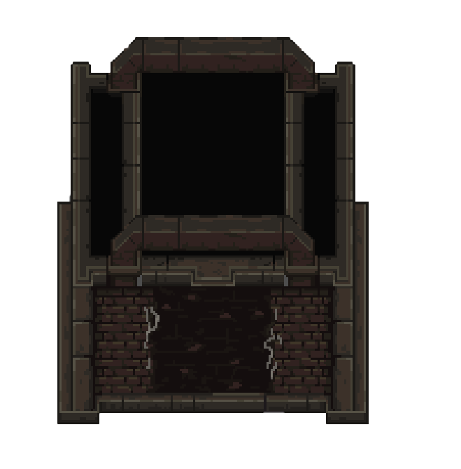
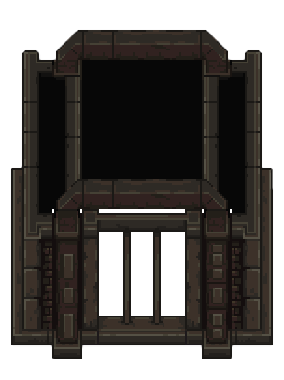
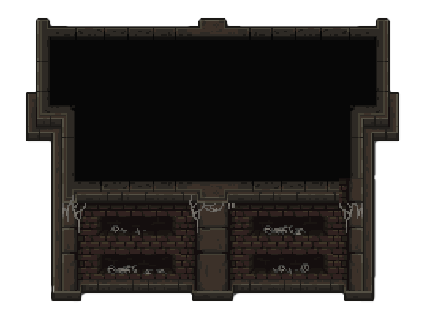
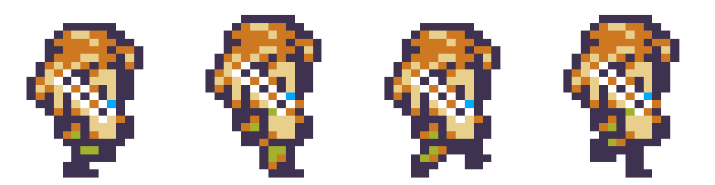
individual responsibilities
cree
Level design
Buildings and decorations
Collision detection
Main character design

Slide 8
Individual Responsibilities
Sean
Round System
Player Shooting
Enemy movement
Health Bar
Character Attributes
User Interface
Player shooting
Health Bar

Slide 9
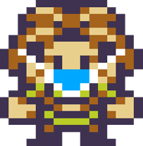
Challenges Overcame
Player movement
Implementing player movement was our first major challenge
Main level creation
Creating the level was our greatest and longest challenge to overcome
The level had been worked on since the start of the project
Round System
Implementing player movement was our first major challenge

